Slide 1
Weekly Report
25/03/2020

Slide 2
Rapidly-exploring Random Tree (RRT) https://blog.csdn.net/songyunli1111/article/details/81982298

Slide 3
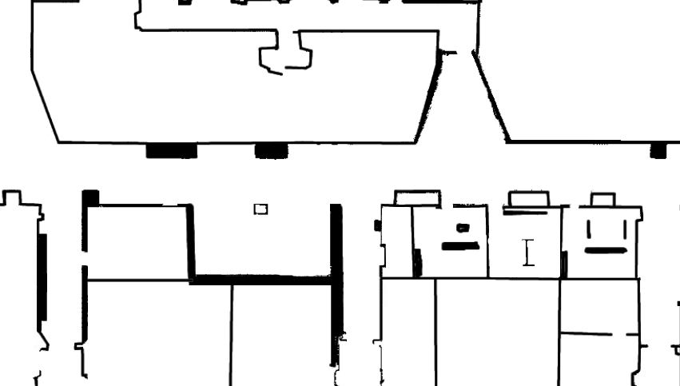

Slide 10
Current issue

Slide 11
Intersect with obstacle

Slide 12
Intersect with obstacle

Slide 13
Failed to find a path in a finite number of searches

